Slide 1
Unit 7.1
Function

Slide 2
Introduction
A function is a block of code that performs a specific task.
A function is a set of statements that take inputs, do some specific computation and produces output.
The idea is to put some commonly or repeatedly done task together and make a function, so that instead of writing the same code again and again for different inputs, we can call the function.
Function helps in dividing complex problem into small components makes program easy to understand and use.

Slide 3
Types of function
Depending on whether a function is defined by the user or already included in C compilers, there are two types of functions in C programming
There are two types of function in C programming:
Standard library functions
User defined functions

Slide 4
Standard library functions
The standard library functions are built-in functions in C programming to handle tasks such as mathematical computations, I/O processing, string handling etc.
These functions are defined in the header file. When you include the header file, these functions are available for use. For example:
The printf() is a standard library function to send formatted output to the screen (display output on the screen). This function is defined in "stdio.h" header file.
There are other numerous library functions defined under "stdio.h", such as scanf(), fprintf(), getchar() etc. Once you include "stdio.h" in your program, all these functions are available for use.

Slide 5
User-defined function
Functions created by the user are called user-defined functions.
User defined function has basically following characteristics
A function is named with unique name
A function performs a specific task
A function is independent
A function may receive values from the calling program (caller)
A function may return a value to the calling program

Slide 6
Example
#include <stdio.h>
int addNumbers(int a, int b); // function prototype
int main()
{
int n1,n2,sum;
printf("Enters two numbers: ");
scanf("%d %d",&n1,&n2);
sum = addNumbers(n1, n2); // function call
printf("sum = %d",sum);
return 0;
}

Slide 7
int addNumbers(int a,int b) // function definition
{
int result;
result = a+b;
return result; // return statement
}

Slide 8
Function Components
Function prototype
A function prototype is simply the declaration of a function that specifies function's name, parameters and return type. It doesn't contain function body.
A function prototype gives information to the compiler that the function may later be used in the program.
Syntax of function prototype
returnType functionName(type1 argument1, type2 argument2,...);

Slide 9
For example
int addNumbers(int a, int b);
It is the function prototype which provides following information to the compiler:
name of the function is addNumbers()
return type of the function is int
two arguments of type int are passed to the function
The function prototype is not needed if the user-defined function is defined before the main() function.

Slide 10
Function definition
Function definition contains the block of code to perform a specific task
Syntax of function definition
returnType functionName(type1 arg1, type2 arg2, ...)
{
//body of the function
}
When a function is called, the control of the program is transferred to the function definition. And, the compiler starts executing the codes inside the body of a function.

Slide 11
Calling a function
Control of the program is transferred to the user-defined function by calling it.
Syntax of function call
functionName(argument1, argument2, ...);
For example
void main()
{
addNumbers(n1,n2); }

Slide 12
Passing arguments to a function
In programming, argument refers to the variable passed to the function.
In the above example, two variables n1 and n2 are passed during function call.
The parameters a and b accepts the passed arguments in the function definition. These arguments are called formal parameters of the function.
The type of arguments passed to a function and the formal parameters must match, otherwise the compiler throws error.
If n1 is of char type, a also should be of char type. If n2 is of float type, variable b also should be of float type.
A function can also be called without passing an argument.

Slide 13
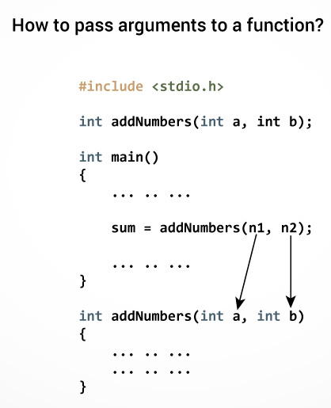

Slide 14
Return Statement
The return statement terminates the execution of a function and returns a value to the calling function.
The program control is transferred to the calling function after return statement.
In the above example, the value of variable result is returned to the variable sum in the main() function.

Slide 15
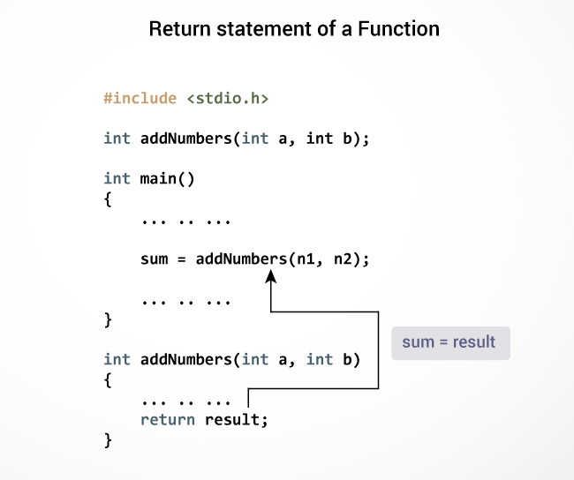

Slide 16
Syntax of return statement
return (expression);
For example,
return a;
return (a+b);
The type of value returned from the function and the return type specified in function prototype and function definition must match.

Slide 17
Types of User-defined Functions in C Programming
No arguments passed and no return value
No arguments passed but a return value
Argument passed but no return value
Argument passed and a return value

Slide 18
C Recursion
A function that calls itself is known as a recursive function. And, this technique is known as recursion.

Slide 19
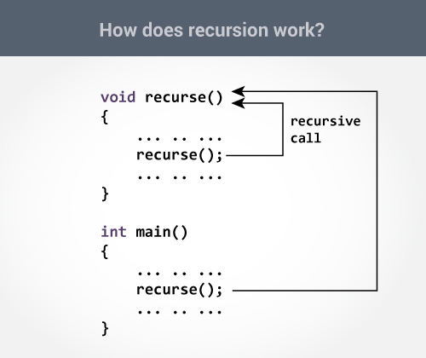
How recursion works?
void recurse()
{
... .. ...
recurse();
... .. ...
}
int main()
{
... .. ...
recurse();
... .. ...
}

Slide 20
The recursion continues until some condition is met to prevent it.
To prevent infinite recursion, if...else statement (or similar approach) can be used where one branch makes the recursive call and other doesn't.

Slide 21
Sum of Natural Numbers Using Recursion
#include <stdio.h>
int sum(int n);
int main()
{
int number, result;
printf("Enter a positive integer: ");
scanf("%d", &number);
result = sum(number);
printf("sum = %d", result);
return 0;
}

Slide 22
int sum(int num)
{
if (num!=0)
return num + sum(num-1); // sum() function calls itself
else
return num;
}

Slide 23
Initially, the sum() is called from the main() function with number passed as an argument.
Suppose, the value of num is 3 initially. During next function call, 2 is passed to the sum() function. This process continues until num is equal to 0.
When num is equal to 0, the if condition fails and the else part is executed returning the sum of integers to the main() function.

Slide 24
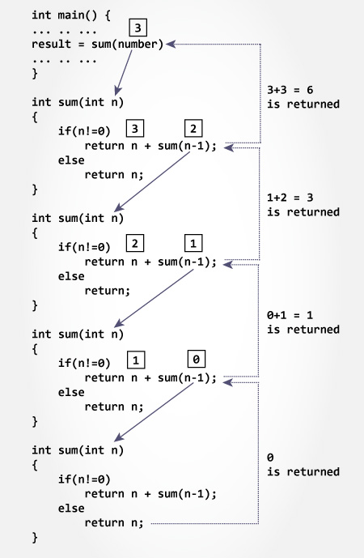

Slide 25
Advantages and Disadvantages of Recursion
Recursion makes program elegant and more readable. However, if performance is vital then, use loops instead as recursion is usually much slower.
Note that, every recursion can be modeled into a loop.
Recursion Vs Iteration? Need performance, use loops, however, code might look ugly and hard to read sometimes. Need more elegant and readable code, use recursion, however, you are sacrificing some performance.

Slide 26
How to pass arrays to a function
Passing One-dimensional Array to a Function
Passing a single element of an array to a function is similar to passing variable to a function.
#include <stdio.h>
void display(int age)
{
printf("%d", age);
}
void main()
{
int a[] = {2, 3, 4};
display(a[2]); //Passing array element a[2]
}

Slide 27
Passing an entire array to a function
#include <stdio.h>
float average(int []);
void main()
{
float avg;
int age[] = {23, 55, 22, 5, 40, 18};
avg = average(age); // Only name of an array is passed as an argument
printf("Average age = %.2f", avg);
}

Slide 28
float average(int age[])
{
int i,sum=0;
float avg;
for (i = 0; i < 6; ++i) {
sum += age[i];
}
avg = (float)sum / 6;
return avg;
}

Slide 29
Passing Multi-dimensional Arrays to Function
To pass multidimensional arrays to a function, only the name of the array is passed (similar to one dimensional array).
#include <stdio.h>
void displayNumbers(int num[2][2]);
void main()
{
int num[2][2], i, j;
printf("Enter 4 numbers:\n");
for (i = 0; i < 2; ++i)
for (j = 0; j < 2; ++j)
scanf("%d", &num[i][j]);
displayNumbers(num); // passing multi-dimensional array to a function
}

Slide 30
void displayNumbers(int num[2][2])
{
int i, j;
printf("Displaying:\n");
for (i = 0; i < 2; ++i)
for (j = 0; j < 2; ++j)
printf("%d\n", num[i][j]);
}

